Slide 1

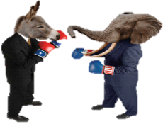
2014 Election Updates & Insights
2014 Election Updates & Insights
Matt Bales
Research Director
mbales@ncfef.org
(919) 996-9543
Joe Stewart
Executive Director
jstewart@ncfef.org
(919) 614-0520

Slide 2
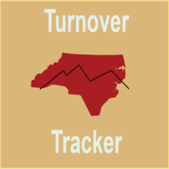

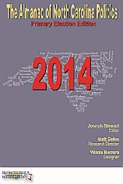
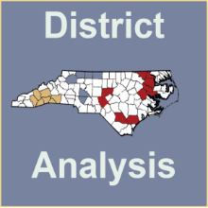
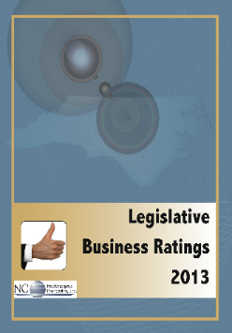
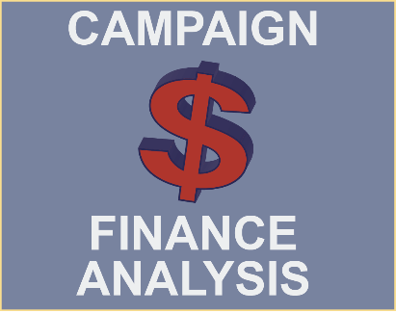
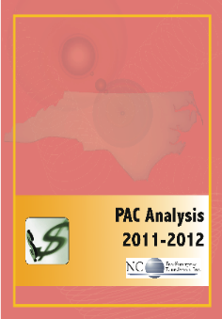



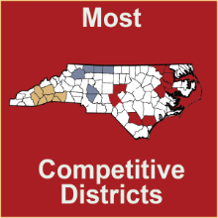
NC FreeEnterprise Foundation
The North Carolina FreeEnterprise Foundation is a 501(c)(3) nonprofit organization exclusively focused on providing innovative educational programs to foster informed civic involvement and a better understanding of how voters perceive key public policy issues that impact our state’s economic vitality.
NCFEF does not lobby, or participate in any way with political campaigns.
Notes:
Joe’s Slide

Slide 3



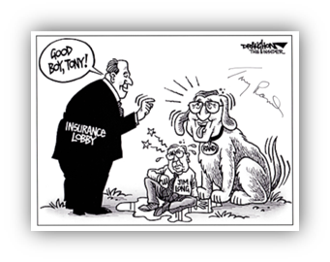

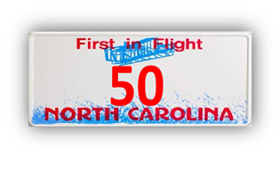

Joe Stewart, Executive Director
Notes:
Joe’s Slide

Slide 4

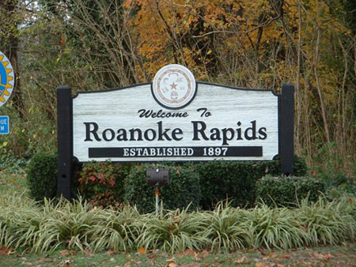

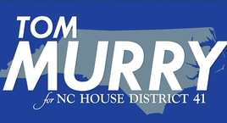

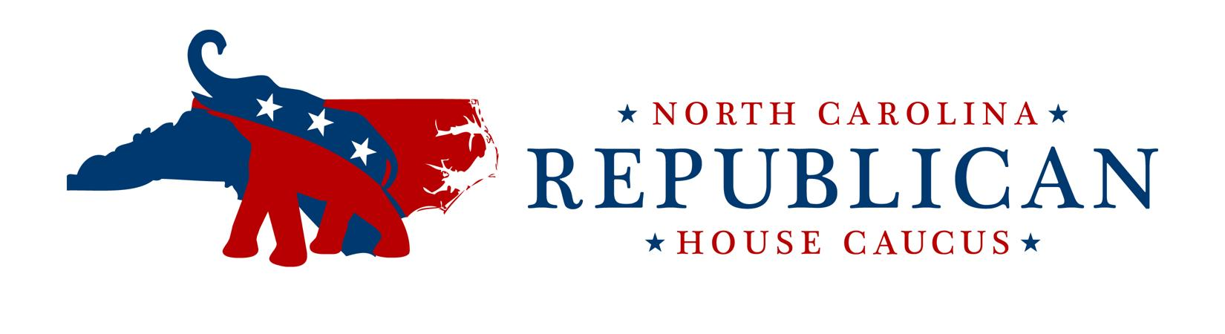
Matt Bales, Research Director
Notes:
Joe’s Slide

Slide 5
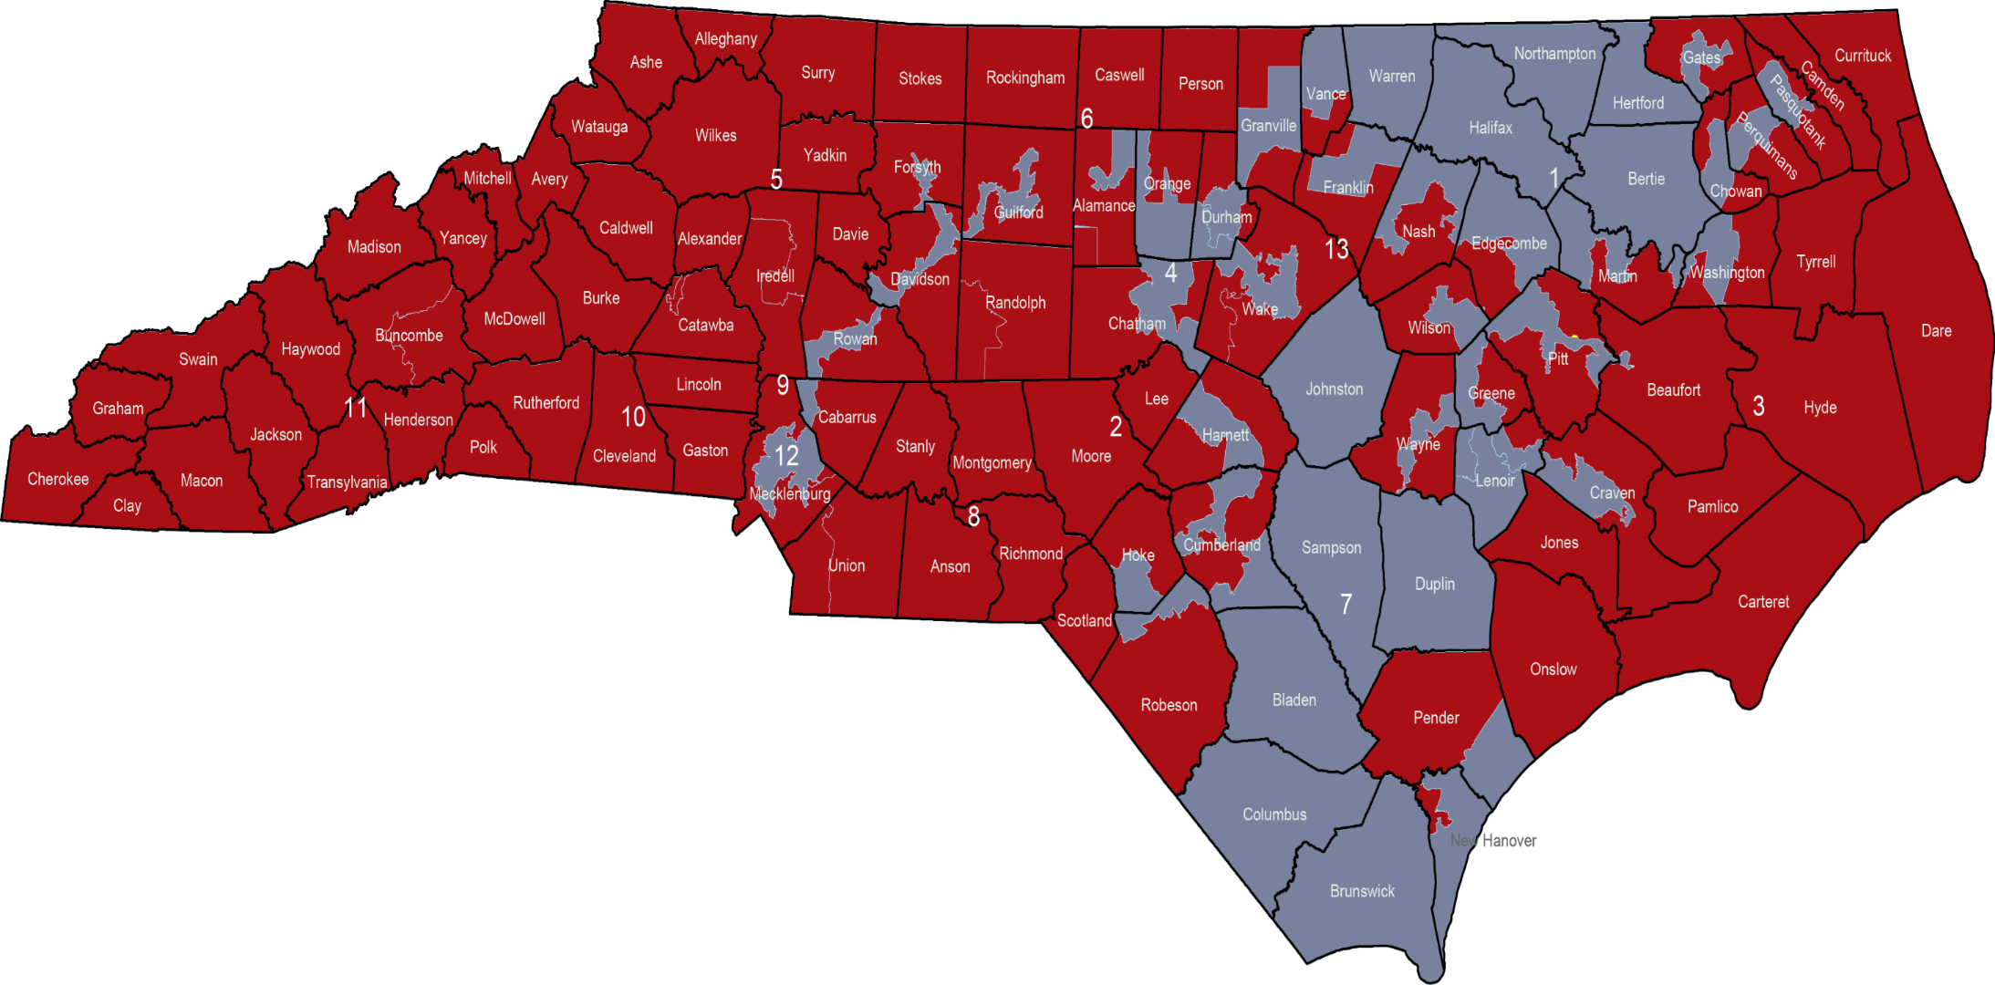
Current NC Congressional Districts
Notes:
This is a map that shows which party controls each congressional district after the 2012 election cycle. The current makeup our Congressional delegation is 9 Republicans and 4 Democrats. Congressional District 7 is always a top target for the Republicans, but Congressman McIntyre has an uncanny ability of raising the dollars needed to win re-election, even sometimes bucking his national party and President.

Slide 6
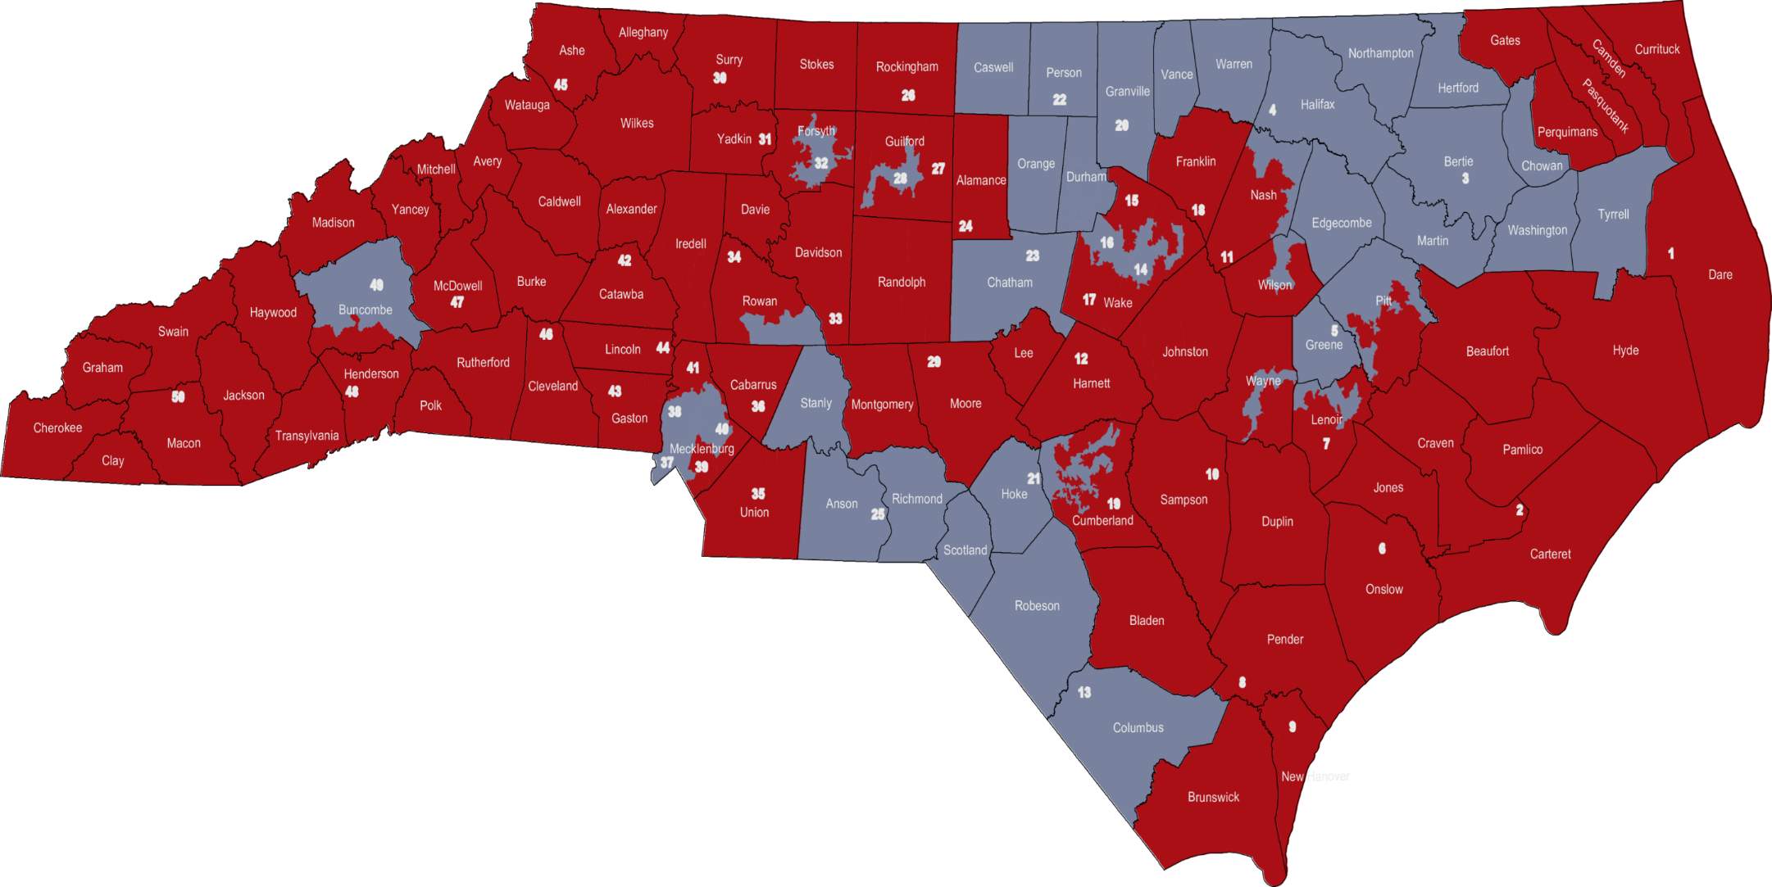
Current NC Senate Districts
Notes:
33-17

Slide 7
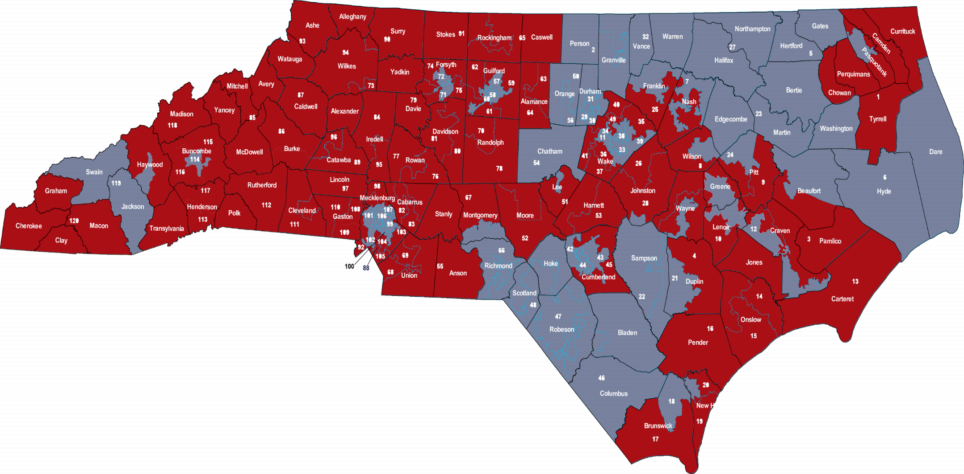
Current NC House Districts
Notes:
77-43

Slide 8
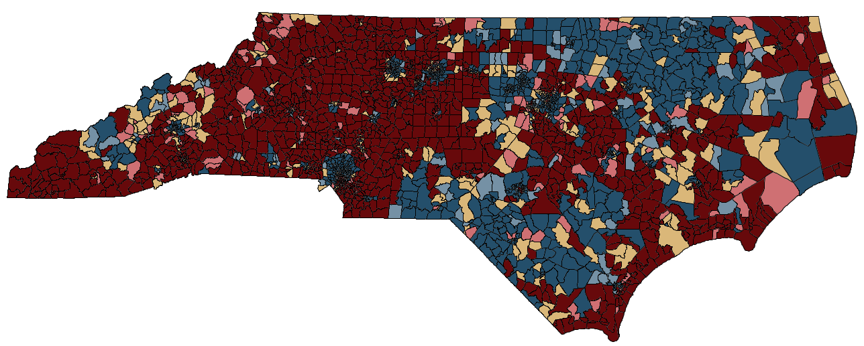
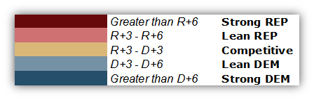
Conventional Voter Behavior (CVB)

Slide 9
CVB Factoids
Of 2,692 Voting Tabulation Districts (similar to precincts):
The highest CVB Strong Republican VTD is in Avery County (R+37.93) and the highest CVB Strong Democratic VTD is in Wilson County (D+47.17).
Of the 283 VTDs that have CVBs in the Competitive category, only 3 VTDs have a CVB of 0.0% (they are located in Wake, Cumberland, and Nash counties).
Of the other Competitive VTDs, 154 have slight Republican leanings and 124 slight Democratic leanings.

Slide 10
2014 US Senate Elections
WA
MT
ND
ME
MN
OR
VT
NH
ID
SD
WI
NY
MA
WY
MI
RI
IA
NJ
CT
NV
NE
PA
IL
IN
OH
MD
DE
UT
WV
CA
CO
KS
MO
VA
KY
TN
NC
AZ
OK
AR
SC
NM
MS
AL
GA
TX
HI
LA
FL
AK

Slide 11
2014 US Senate Competitive Races
WA
MT
ND
ME
MN
OR
VT
NH
ID
SD
WI
NY
MA
WY
MI
RI
IA
NJ
CT
NV
NE
PA
IL
IN
OH
MD
DE
UT
WV
CA
CO
KS
MO
VA
KY
TN
NC
AZ
OK
AR
SC
NM
MS
AL
GA
TX
HI
LA
FL
AK

Slide 12
US Senate

Slide 13
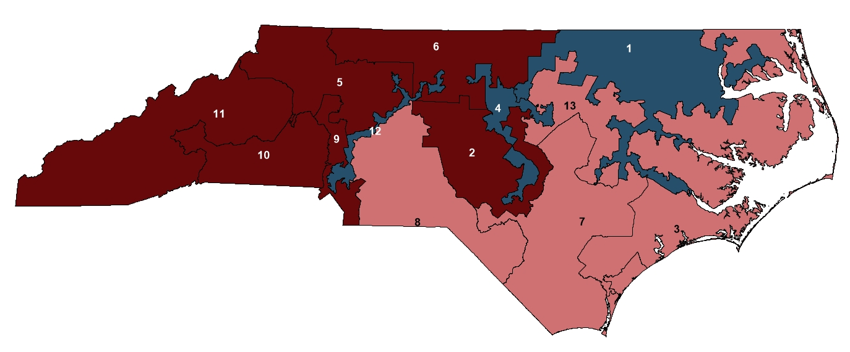

2014 US Congress CVB Map

Slide 14
US Congress CVB Breakdown

Slide 15
US Congress

Slide 16
US Congress

Slide 17
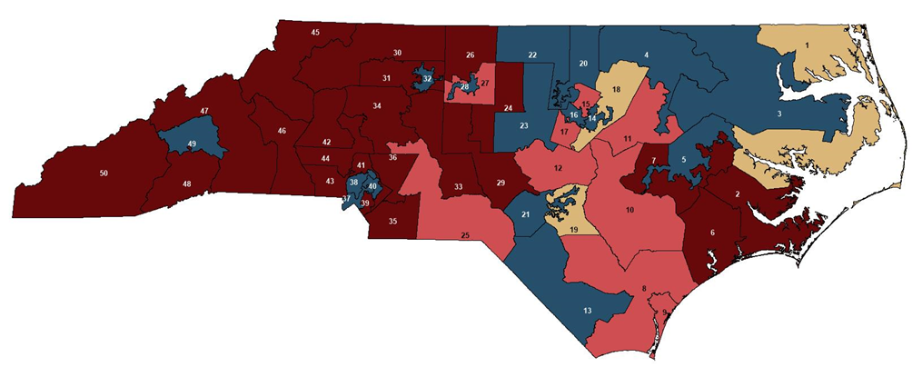
2014 NC Senate CVB Map

Slide 18
NC Senate CVB Breakdown

Slide 19
NC Senate

Slide 20
NC Senate

Slide 21
NC Senate

Slide 22
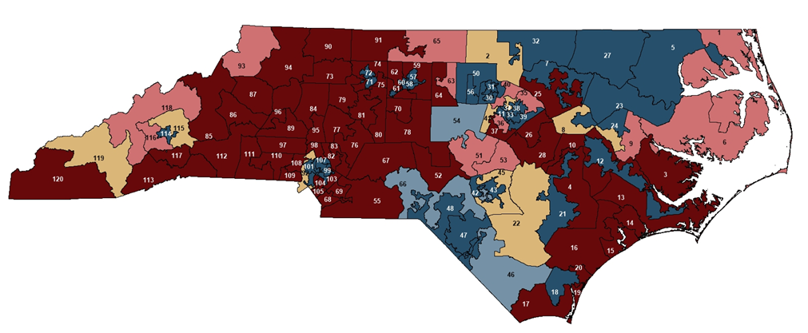
2014 NC House CVB Map

Slide 23
NC House CVB Breakdown

Slide 24
NC House

Slide 25
NC House

Slide 26
NC House

Slide 27
NC House

Slide 28
NC House

Slide 29
NC House

Slide 30
NC Supreme Court

Slide 31
NC Court of Appeals

Slide 32
Voter Enthusiasm Gap
Source: Pew Research

Slide 33
Republican Voter Enthusiasm
Source: Pew Research

Slide 34
Democratic Voter Enthusiasm
Source: Pew Research

Slide 35
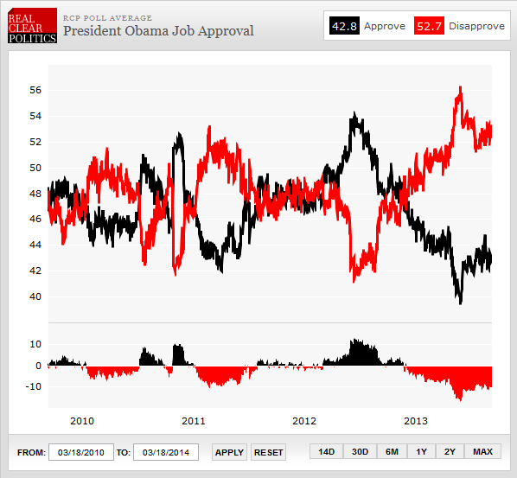
President Obama Job Approval

Slide 36
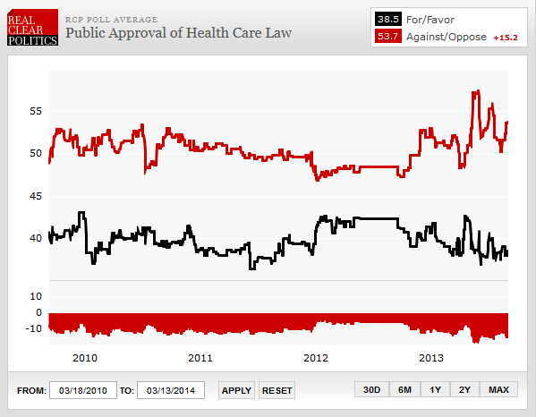
Public Approval of Health Care Law

Slide 37
Sen. Hagan Job Approval

Slide 38
NC Generic Ballot

Slide 39
NCGA Approval/Disapproval

Slide 40
NCGA Approval: GOP

Slide 41
NCGA Approval: DEM

Slide 42
Party Affiliation
Updated: April 3, 2014
Source: NC State Board of Elections

Slide 43
Party Affiliation Since 2010
Source: NC State Board of Elections

Slide 44
Top 20 Counties of Registered Voters
D+500,000 voters in Top 20 Counties

Slide 45
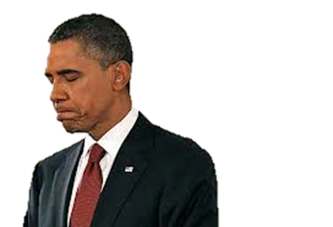
What’s Driving Voter Attitudes
Source: Aggregated Gallup data, August 2013 - March 2014

Slide 46
Who’s Voting for Whom in 2014
Source: POS

Slide 47
2014 Election Updates & Insights
2014 Election Updates & Insights
Matt Bales
Research Director
mbales@ncfef.org
(919) 996-9543
Joe Stewart
Executive Director
jstewart@ncfef.org
(919) 614-0520

