Slide 1
We’re Moving Forward
Wiley W. Jones III, PE
State Pavement Construction Engineer

Slide 2
We’re Moving Forward
Continuous Improvement Processes – Mix Consolidation
OGFC (FC-1 Modified)
Tack Coat Installation/Inspection Basics
Timely Project Delivery
New Product Approved by NCDOT- Utility Manhole Adjustment
Prestaging of Traffic Control to maximize available work time/minimize the number of days traffic is impacted
Holiday Time Restrictions- Perform work on non-primary system roads with minimal impacts to holiday travelers.

Slide 3
Superior Performing Asphalt Pavements
Superpave stands for Superior Performing Pavement
It is based on the principle that superior performance will occur when the asphalt concrete mix is correctly matched to the intended use.
Pavements need to be designed based upon the traffic loading and the distresses you are trying to correct.
Do not select a higher level mix than required, e.g., don’t use a “C” level mix when an “A” level will do.
Pavement performance will only be as good as the materials you select.

Slide 4
Continuous improvement is better than delayed perfection. – Mark Twain

Slide 5
Asphalt Mix Design is a Balancing Act Between
Rutting
Cracking

Slide 6
Mix Consolidation and 2018 Spec Changes What do you need to know?
We are trying to allow for more durable mixes while still protecting against rutting
Diminishing the Job Mix Formulas with poor rut performance
Reducing the gyration level for S9.5C mixes to allow for more asphalt binder content
Removing all S12.5X Mixes
Consolidating to one Intermediate Mix Type (I19.0C) and one Base Mix Type (B25.0C)
Decreasing the need for PG 70-22 binder
Compaction requirements are the same, but look different due to naming of mix types.
Basing the amount of recycled material based upon the percentage of asphalt binder rather than weight.
Designers need to select the appropriate surface mix for the anticipated traffic demand
Goes into effect with the February 2018 letting

Slide 7
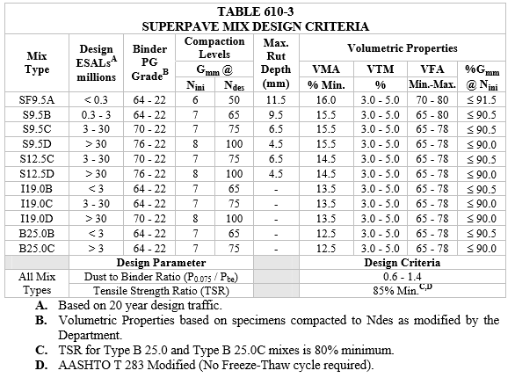
2012 Mix Types
Table 610-3 is used to show the different Mix Types that should be used for the anticipated Design EASLs.
You can also see the PG Binder grade used for each mix.
The suffix letter for each mix type describes the anticipated traffic loading expected.
A -Lightest anticipated EASL
B- Moderate EASL Loading
C –Substantial Traffic Loading
D- Interstate Traffic Loadings

Slide 8
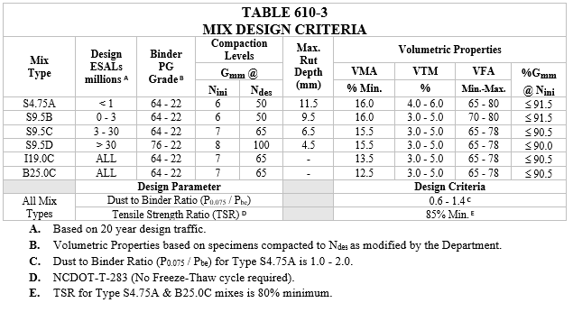
New Consolidated Mix Types
Simplified – Only 1 mix type for Intermediate and Base Mixes
Removed S12.5X mixes
S9.5D Mix remained unchanged
No more mixes with PG 70-22 binder
Gyration Levels set to allow for more asphalt content to be included in the mix design, hopefully increasing durability and resistance to cracking

Slide 9
Side by Side Comparison
2017 Asphalt Mixes
2018 Consolidated Asphalt Mixes

Slide 10
Mix Consolidation – Elimination of I19.0D
I19.0D mix was typically used on Interstate Facilities
It also used the PG 70-22 unless RAS/RAP contributing binder bumped down to PG 64-22.
Since I19.0 is commonly 1 ½” to 3” inches below the final wearing surface, there is a belief the additional rutting will not be effected.

Slide 11
Mix Consolidation
Binder Grade Requirements
Table 610-5 is eliminating the need for PG 70-22
If 21% ≤ Recycled Binder Replacement % ≤ 30% and shingles are used, then PG 58-28 shall be used as the additional binder

Slide 12
Placement Temperatures
Minimum Surface and Air Temperature
All Base and Intermediate Mixes
35°F
S4.75, S9.5B, and S9.5C Mixes
40°F
S9.5D
50°F

Slide 13
Density Requirements by Mix Type
Minimum % Gmm (Maximum Specific Gravity)
S4.75 (when mix is placed at rate of 100 lbs./SY or higher)
No Significant Change
85.0% of G_{mm}
S9.5B (old SF9.5A)
90.0% of G_{mm}
S9.5C, S9.5D, I19.0C and B25.0C
No Significant Change
92.0% of G_{mm}

Slide 14
Implementation Schedule (Moving Ahead)
All new projects should be designed using the consolidated mix types.
For those projects already designed with the older 2012 Asphalt Mix Types, a project special provision will be included to change over the line items to the consolidated line items. (SP06 R65 and SP06 R66)
January 12, 2018 Memo from Lamar Sylvester
Mix Designs with New Nomenclatures need to be used beginning with the February Letting.
All projects in the March 2018 letting or after, need to have typical sections revised to reflect consolidated asphalt mix types.
Contractor’s are currently submitting JMFs for 2018 Asphalt Mix Designs

Slide 15
Implementation Schedule (Moving Ahead)
Contractor’s are currently submitting JMF’s for 2018 Asphalt Mix Designs
Contractors submitting QMS-6 for 2018 AMD’s on priority needed basis
If an existing JMF is converted to 2018 Mix Type
Not requiring TSR (unless production TSR was never performed)
No need for new control strip for nuclear control if less than 14 days old
Monday placing SF9.5A – Tuesday Placing new 2018 JMF S9.5B – no need to redo control strip

Slide 16
Implementation Schedule (Projects already Let)
Contractor can elect to continue placing 2017 or older JMFs to complete existing projects.
Projects already under construction may use a 2018 JMF, provided a no cost supplemental agreement is executed and the mix types are confirmed to be the types originally requested.
Will need to adjust the CBOM in HiCAMS to allow for the material to be included under the line item.

Slide 17
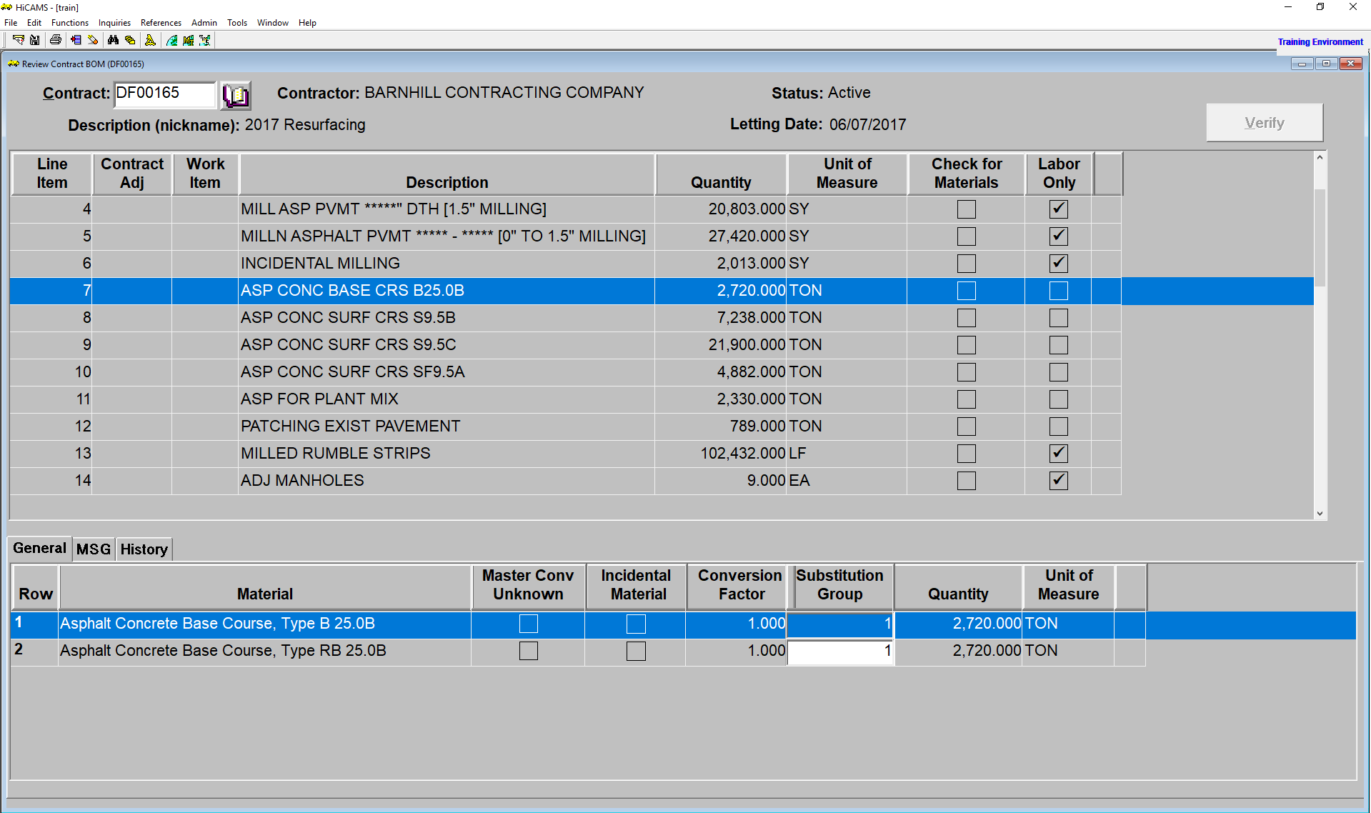

Slide 18
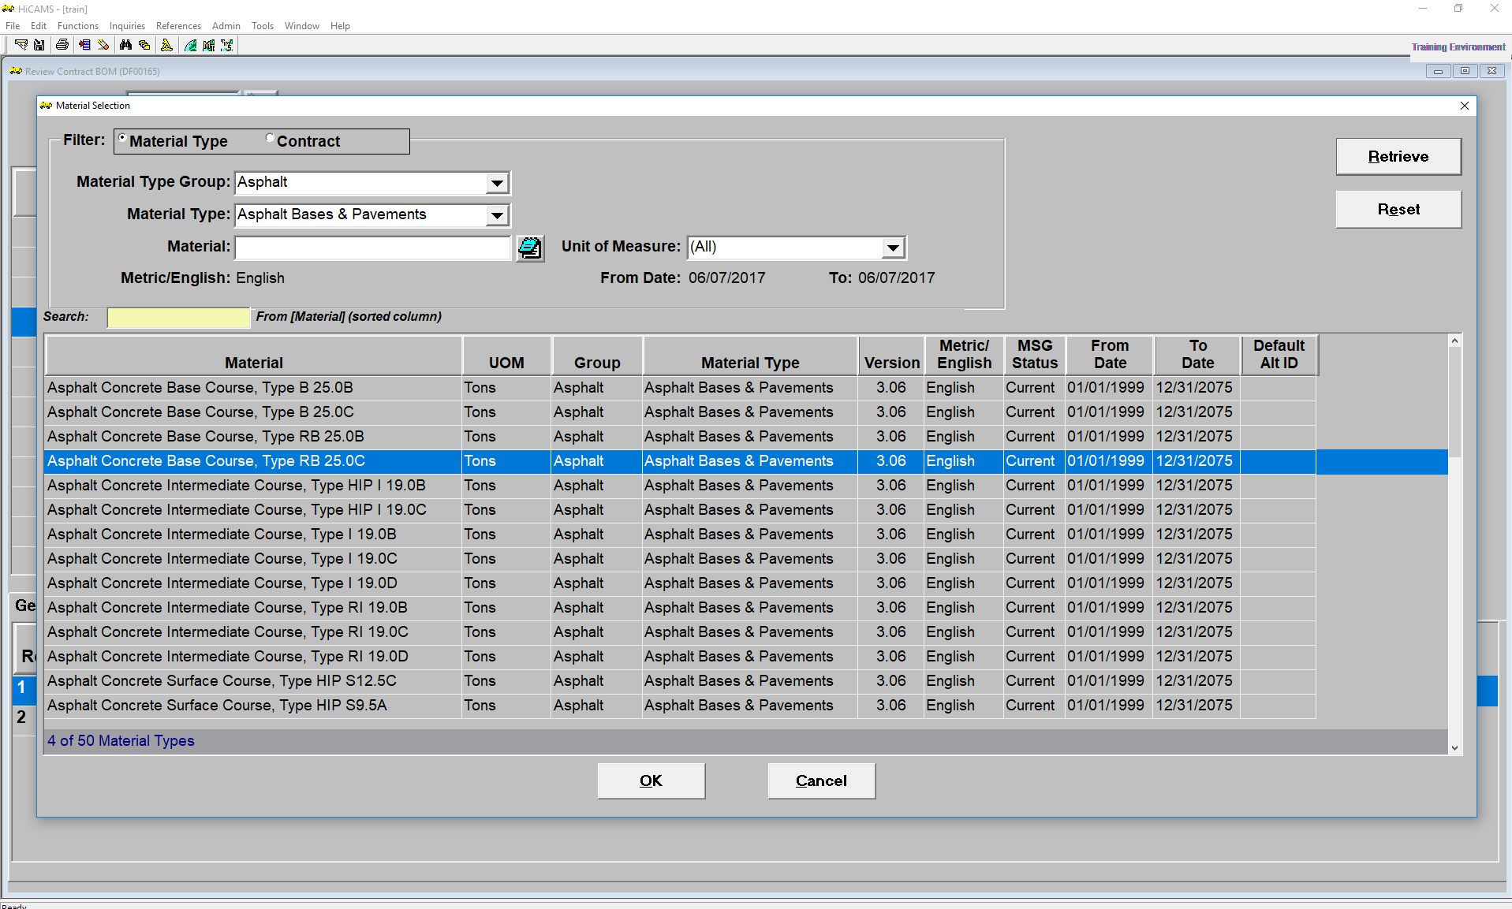

Slide 19
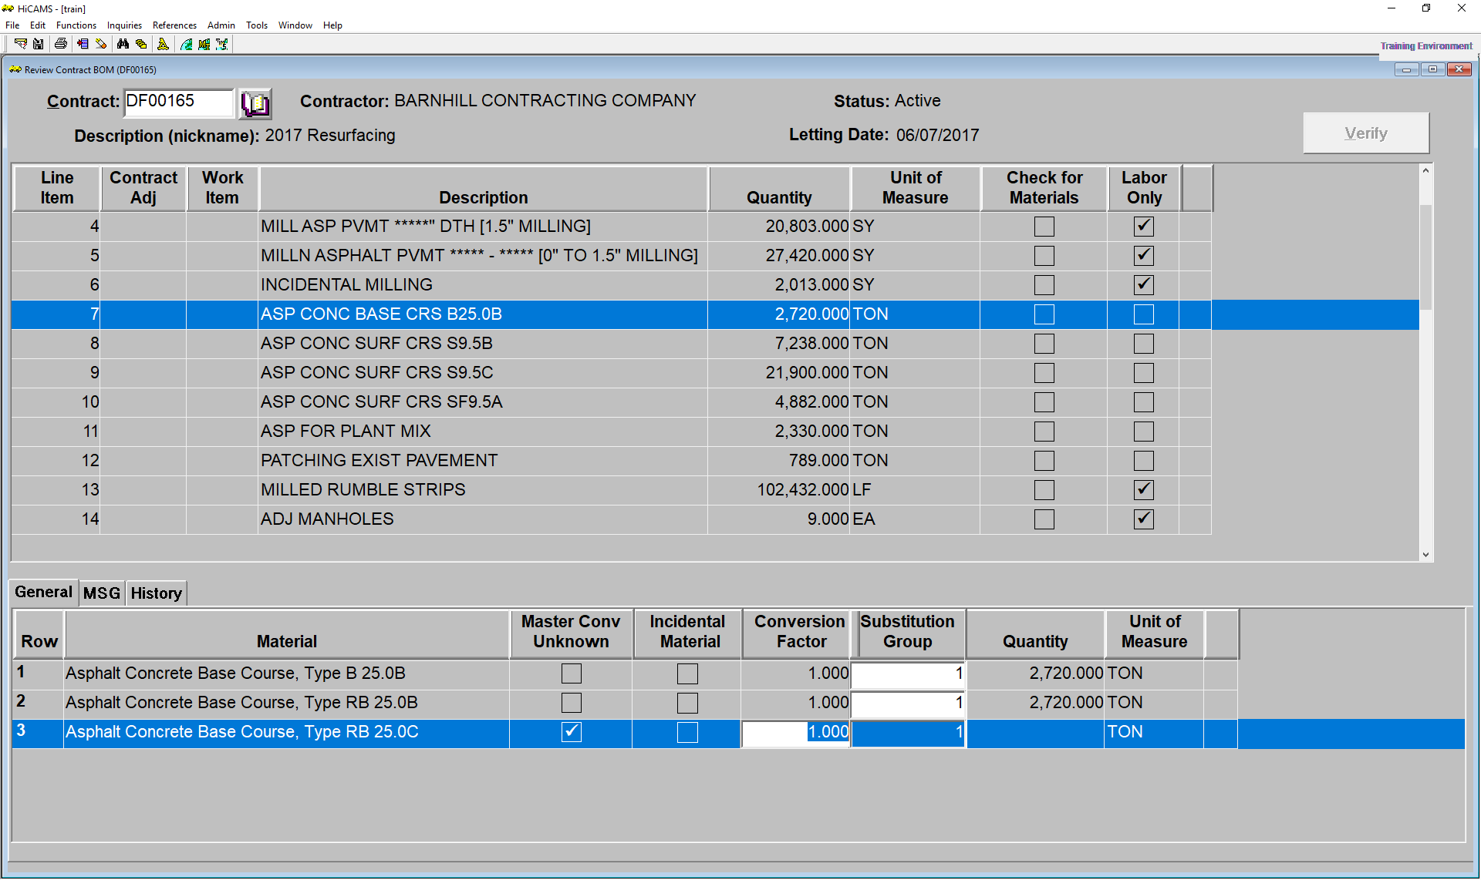

Slide 21
Name changes for mixes
Old SF9.5A now becomes the S9.5B
Can be used up to 3 million EASLs
Old S9.5B now becomes S9.5C,
Must meet tougher rut standard (max 6.5mm)
Only one intermediate mix type (I19.0C)
Only one base Type (B25.0C)
No longer use the PG 70-22 binder
Designers need to select surface mixes for designed EASLs
Contract Line Items to reflect new mix types in February 2018 letting
Typical sections updated to new mix types in March 2018 letting

Slide 22
Section 650 - Open Graded Friction Course
FC-1 Modified only mix type (Typically placed 3/4” thick)
Tack Coat
PG 64 -22 or PG 58 -28
Applied at 0.06 – 0.08 gallons per square yard
Material Transfer Vehicle required
Pull down to 3/8 inch during the last load for transitions
Do not place on a milled surface – no milled butt joints
Square off pulls- especially near heavy skewed bridges
Compact with rollers in “static” mode only – one coverage
Key is to consistent mat appearance, minimize segregation
Special maintenance treatment – snow and ice

Slide 23
Tack Coat Basics
To promote the bond between pavement layers
Prevent slippage between pavement layers
Vital for structural performance of the pavement
All layers working together

Slide 24
Tack Coat Basics
Terminology
Tack Coat – Sprayed application of asphalt cement upon an existing asphalt or PC concrete pavement prior to an overlay, or between layers of fresh asphalt
Emulsion – an undiluted emulsion which consists of a paving grade binder, water, and an emulsifying agent.
Residual asphalt – the remaining asphalt after an emulsion has set, typically 57-70 percent.
Tack Coat Break – the moment when water separates enough from the asphalt showing a color change from brown to black
Tack Coat Set – when all the water has evaporated, leaving only residual asphalt. Some refer to as completely broken.

Slide 25
Tack Coats
Four essential requirements for satisfactory tack coat application:
1. Existing pavement surface must be thoroughly cleaned.
2. Proper rate of application must be assured. Use Best Practices Field Guide 2012
3. Uniform coverage over the entire area to be paved must be assured.
4. Allow the tack to break and set before paving
Color change
Rice Krispy Test (Snap, Crackle, and Pop)
Heel Test

Slide 26
SPRAY BAR SYSTEM, NOZZLE ANGLE SETTING AND COVERAGE

Slide 27
Obstacles with Getting Good Tack?
Proper Surface Cleaning – tack will stick to whatever is on the pavement
Nighttime paving – difficulty in visibility
High humidity – takes longer for tack to set
Working in cold weather – getting out of the truck
Application rate – NCDOT specifies application rate; not residual asphalt rate
Consistency of application – corn rows or uniform double spray pattern?
Emulsions should not be diluted (watered down)
Tack Coat Pickup by vehicles tracking in front of the paver?

Slide 28
Prepare for Paving Success
Traffic Control Concerns
Prestaging Traffic Control
Checking Typical Sections for correct Mix
Gathering Project Station Information
Estimating # of Test Sections
Is a control strips needed?
Tack Coat
Is the pavement clean?
What rate should be applied?
How many gallons are in the distributor?
What Temperature?

Slide 29
Prepare for Paving Success
Paver Setup
Auger Extensions
Automatic Grade Controls
MTV required
Rolling pattern
How close should I stay to paver
Finish rolling in static mode
Pavement Markings
Paint
School Zones/ No Passing Zones
Interim markings

Slide 30
Emphasis on Timely Project Delivery
New Products
Holiday Time Restrictions
Look for ways to accelerate project while maintaining quality
Three legs of project management:
Cost
Time
Quality

Slide 31
Project Delivery- Project Acceleration New Products
Have a product to submit for inclusion?
Contact the NCDOT Product Evaluation Program
connect.ncdot.gov/resources/products
Innovative Technologies and Product Awareness Report from NCDOT Value Management Unit – December 7, 2017
Pivoted Turnbuckle Manhole Riser – American Highway Products
Approved for Use
Used on project in Division 3 (DC00155)
Check with local municipality since they are the owner of the system

Slide 32
Holiday Time Restrictions
Special Provision SP1 G014 A dated 2-20-07
Division 1
Monday through Friday 30 minutes before sunset and 30 minutes after sunrise.
Saturday from 30 minutes before sunset to 30 minutes after the sunrise on the following Monday
Special Provision SP01 G014B dated 2-20-07
Holiday and Holiday Weekend Lane Closure Restrictions

Slide 33
Holiday Time Restrictions
Special Provision SP01 G014B dated 2-20-07
Holiday and Holiday Weekend Lane Closure Restrictions
If Independence Day is on a Friday, Saturday, Sunday or Monday, then between the hours of [hour] the Thursday before Independence Day and [hour] the Tuesday after Independence Day.
What is the intent?
What if they were working in a subdivision or ADT<1000?
Is it reasonable to allow contractor to work?
Contractors – Ask in advance if this might be a possibility.

Slide 34
Traffic Control Concerns – Prestaging
Are their Lane Closure Restrictions in the Contract?
Is there room on the shoulder to put up the lane closed signs before closing actually closing the lane?
Desire is for contractor to be ready to push drums into lane when time restrictions allow to maximize available work time
More working time each day should reduce number of daily lane closures

Slide 35
Make 2018 the Best Paving Season Ever!
Listen first!
Understand what may be needed to complete the project
Be a part of the solution!
Be proud of the work performed on a daily basis
Strive to be a better today that you were yesterday

