Slide 1
CAPA 2014 Annual Meeting
Construction & Materials Topics
Ron Hancock, PE
State Construction Engineer
Chris Peoples, PE
State Materials Engineer

Slide 2
NCDOT / CAPA Committees
  Joint Technical Committee – Large Group
  Joint Asphalt Committee
  CAPA Members – 2013 CAPA Members - 2014
  Skip Partington – Barnhill Skip Partington - Barnhill
  Ivan Clayton – Sharpe Brothers Tim Rose – Rose Brother
  Reade Dawson – S.T. Wooten Carlton Powell – Ferebee
  Jule Smith - FSC Jim Russell – JTR
  Wiley Roark – Maymead George Marsh - Gelder
  Specs / Training Subcommittee
  CAPA Members NCDOT Members
  David Glover - Barnhill Todd Whittington
  Chris Croom - S. T. Wooten Nilesh Surti
  Berry Hall - Blythe Wesley Welborn
  Marvin Hylton - Apac David Jackson
  Ellis Powell - CAPA Dan Hunter
  Ted Naylor

Slide 3
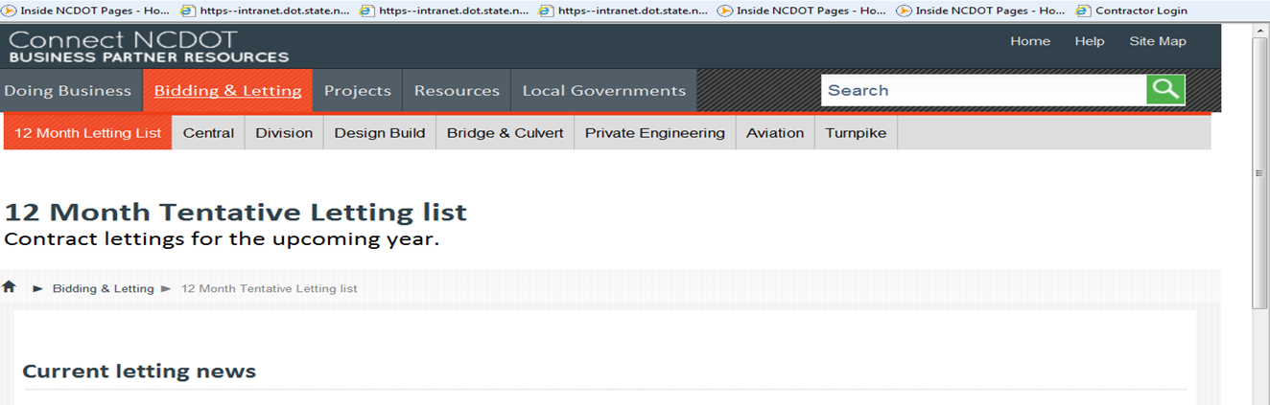
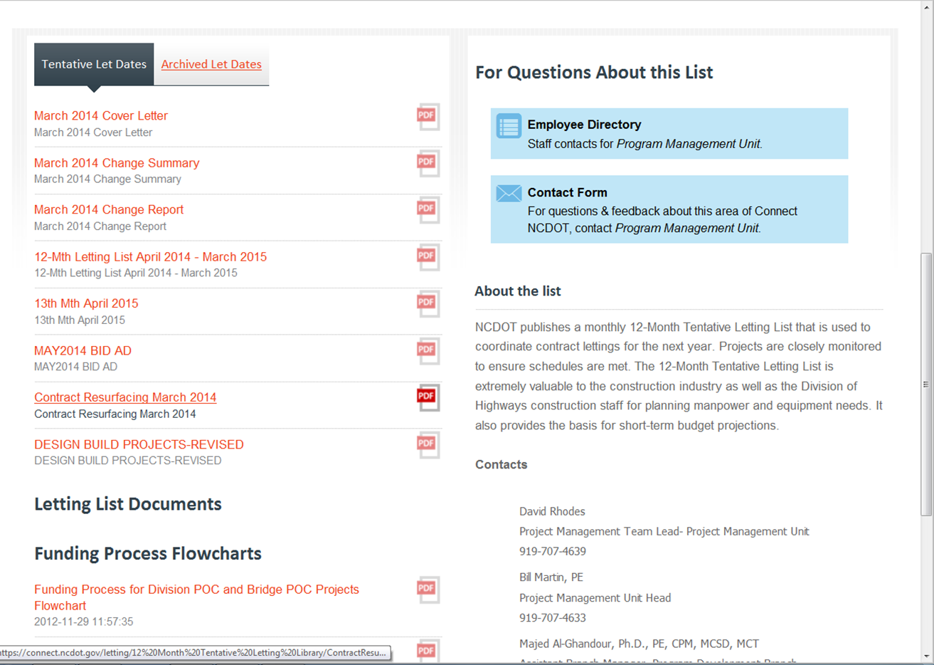

Slide 4
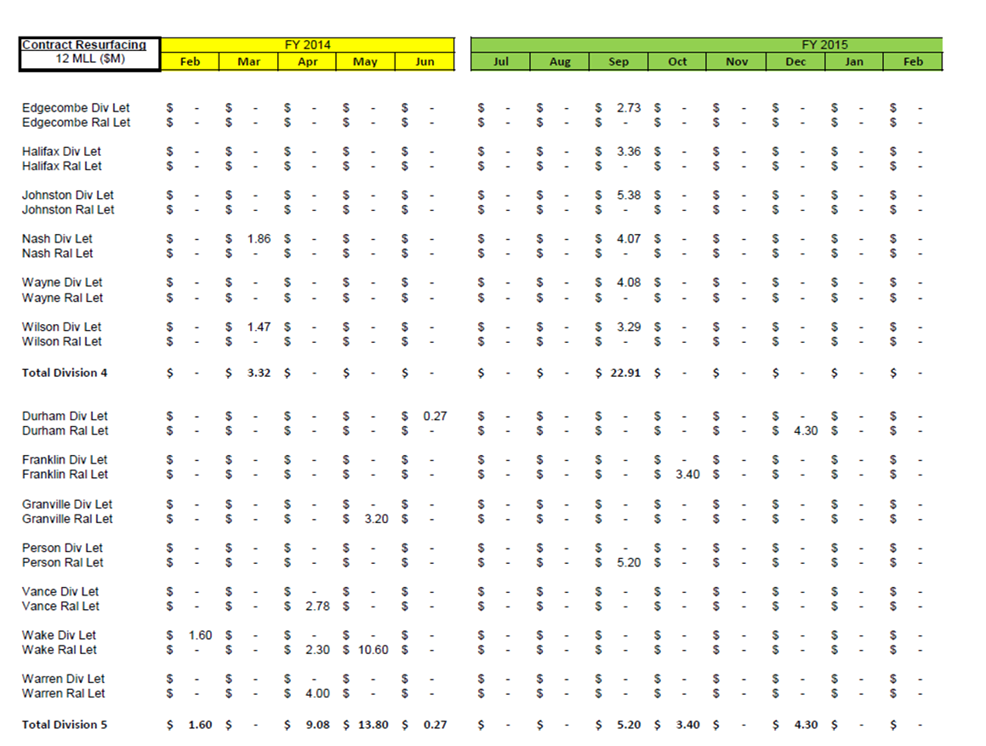
Contract Resurfacing Let List
https://connect.ncdot.gov/letting/12%20Month%20Tentative%20Letting%20Library/ContractResurfacing-12MLL-Feb27-2014.pdf
Notes:
This let list is on the NCDOT Connect website under “Bidding & Letting” and then on “12 Month Tentative Letting List” page. Scroll down to see the Contract Resurfacing list per Division and County for the next 12 months.

Slide 5
Historical Funding for C/R Program
SFY $(M)
2008 277
2009 277
2010 300
2011 267
2012 406
2013 427
2014 433
2015 402

Slide 6
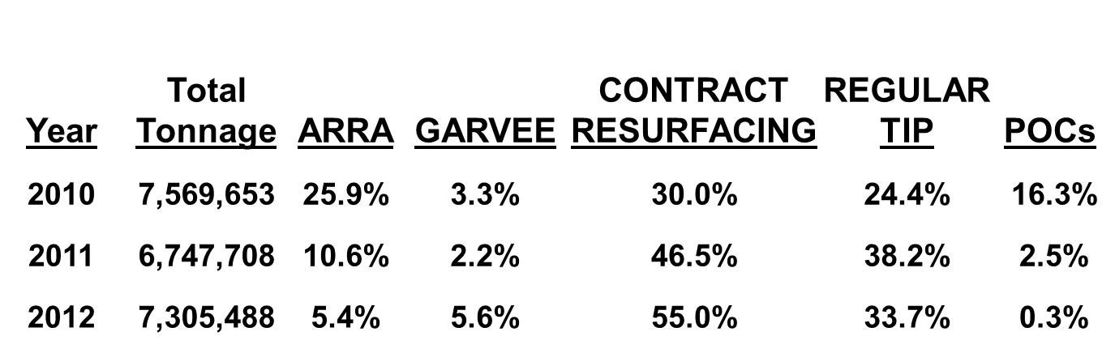
PROGRAM-TONNAGE COMPARISON
2013 6,154,972 1.5% 1.2% 57.5% 38.9% 0.2%

Slide 7
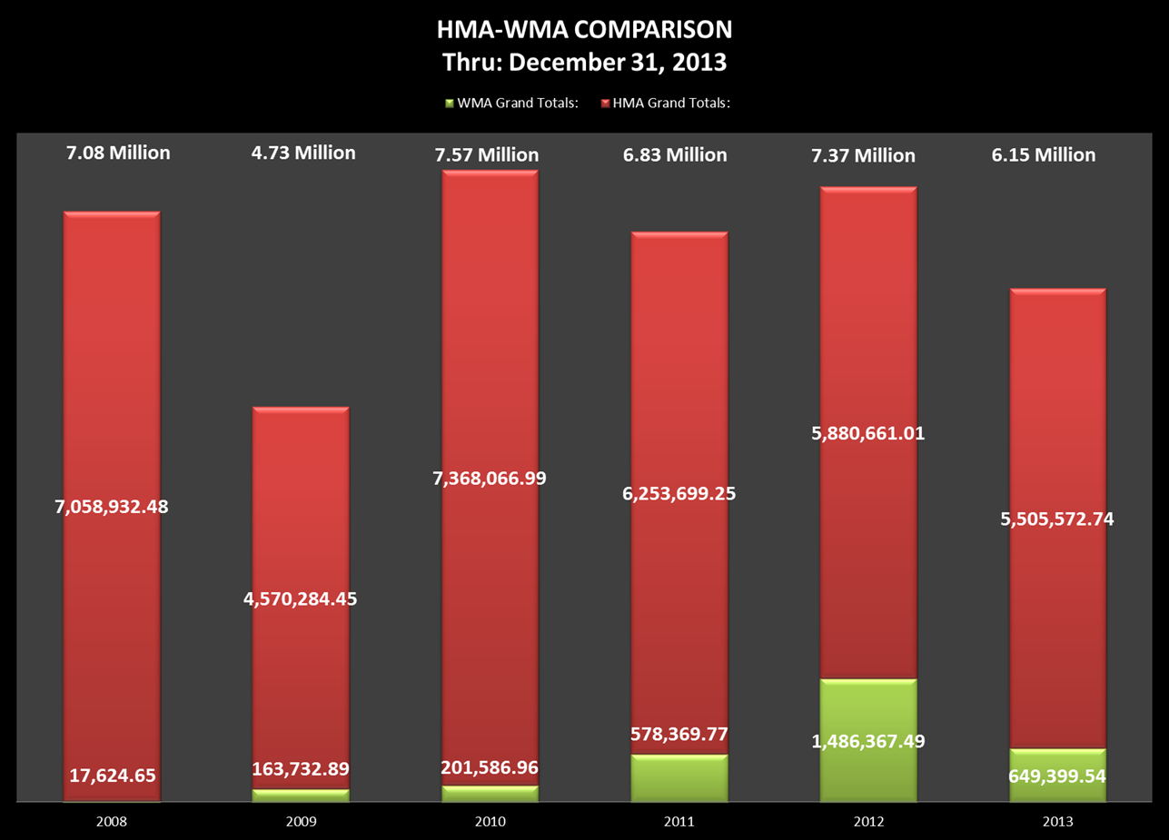
20.2%
8.5%
2.7%
10.6%
3.5%
Notes:
Percentage of WMA over Total Tonnage.

Slide 8
Warm Mix Asphalt
WMA: Over 3.0 million tons placed to date since 2008-09
WMA Status Approvals
Unlimited (any route) > 250,000 tons
Limited (US, NC, SR) > 75,000 tons
Trial (NC, SR) approved for use
See Materials and Tests website for Approved List and Criteria
  9 WMA Processes on the Approved List
  3 with “Unlimited” status

Slide 9
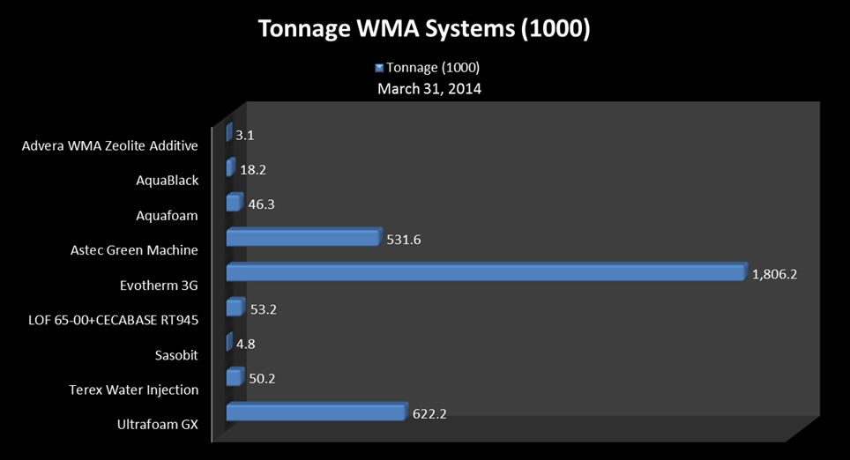
WMA Tonnages – 9 Approved Processes!

Slide 10
Warm Mix Asphalt (WMA)
TABLE 610-1 MIXING TEMPERATURE AT THE ASPHALT PLANT
Binder Grade | HMA JMF Temperature | WMA JMF Temperature Range
PG 64-22 | 300°F | 225 - 275°F
PG 70-22 | 315°F | 240 - 290°F
PG 76-22 | 335°F | 260 - 310°F
Old Note:
When WMA is used, the Asphalt Design Engineer (after consultation with the Contractor) will set the mixing temperature at the plant within the allowable temperature range of 225 °F to 275 °F.
New Note:
The mix temperature, when checked in the truck at the roadway, shall be within plus 15 °F and minus 25 °F of the temperature specified on the JMF.

Slide 11

Other 2013 Specification Changes

Slide 12
Air & Surface Temperatures
TABLE 610-5 PLACEMENT TEMPERATURES FOR ASPHALT
Asphalt Concrete Mix Type | Minimum Surface and Air Temperatures | Minimum Surface Temperature
B25.0B, C | 35°F | 35°F
I19.0B, C, D | 35°F | 35°F
SF9.5A, S9.5B, S4.75A | 40°F | 50°F^{A}
S9.5C, S12.5C | 45°F | 50°F
S9.5D, S12.5D | 50°F | 50°F
Simplified Table with one requirement for both Air and Surface. Still check both and lower temperature controls.
Check temps. away from artificial heat and at location of paving operation.
Wording of “in the shade” has been removed

Slide 13
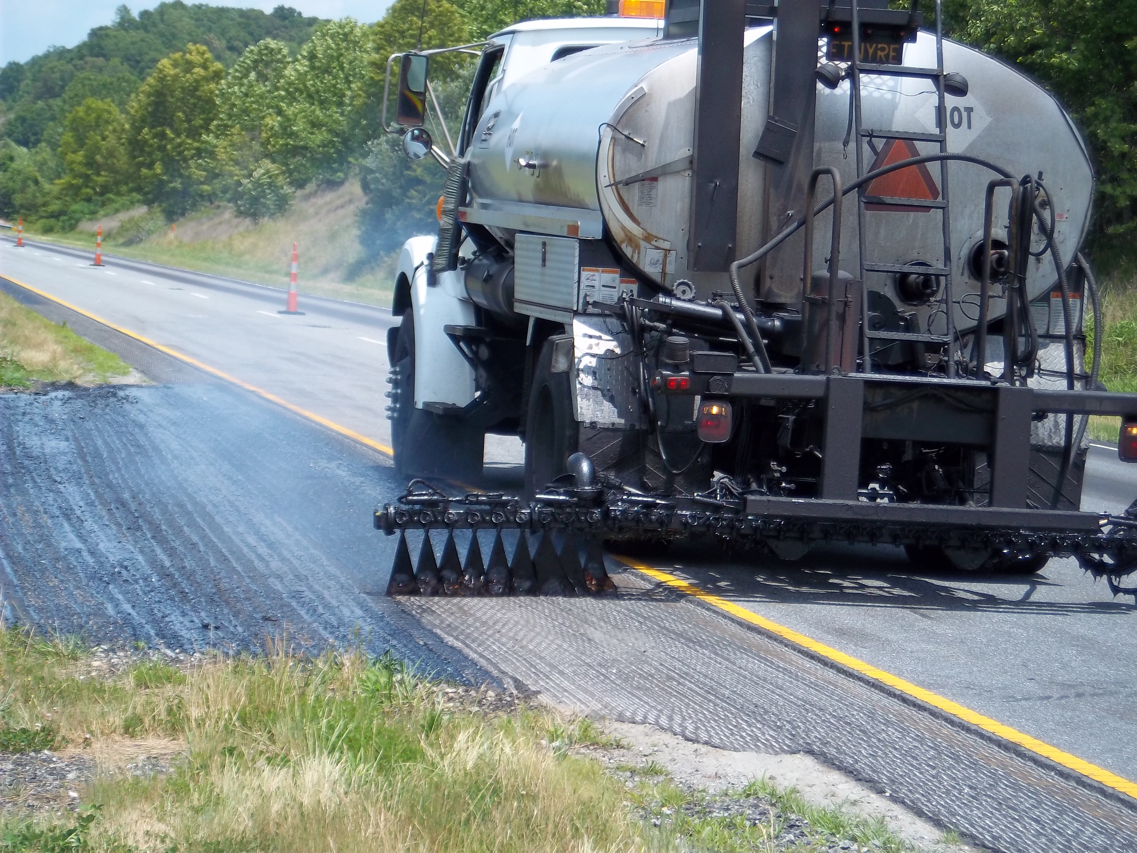
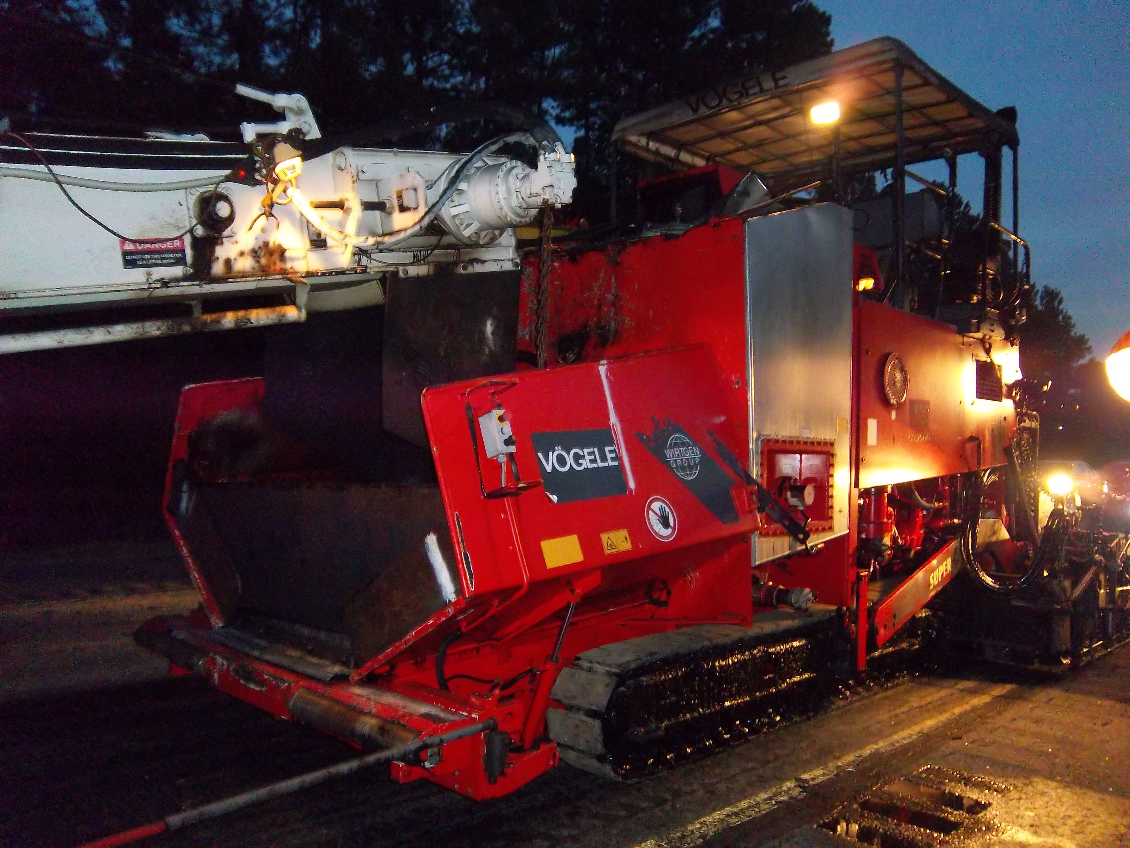
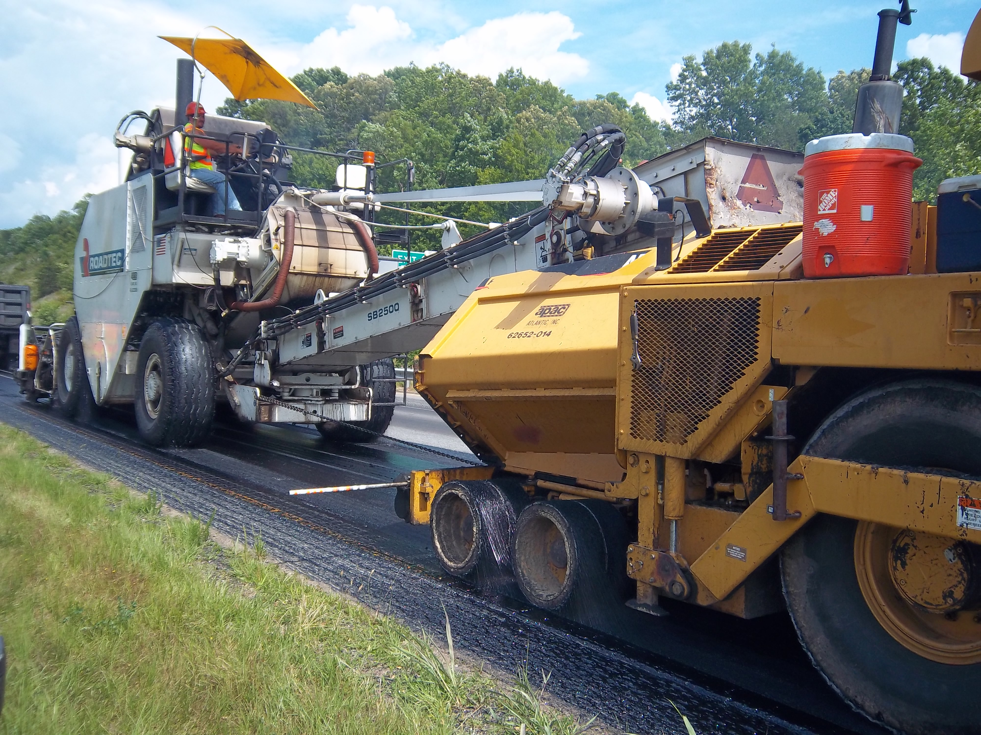
Ultra-Thin Bonded Wearing Course with Alternate Method
  Two pilot projects in 2012
    Divisions 14 and 5
  New SP placed in three contracts
    Divisions 9 and 10
Notes:
Nilesh - More details on the spec change and when will it become a standard

Slide 14
Ultra-Thin Bonded Wearing Course with Alternate Method – Special Provision
SP replaces Section 661 UBWC in Spec Book
Alternate method is an option that allows Contractor to use distributor truck to shoot special non-tracking hot-applied tack and conventional paver to place Ultra-thin
“Application” pay item has been removed
With this SP, only one pay item which is “Ultra-thin” paid for in Tons
Pavement Technical Committee was presented with the SP
Goal to make it a standard later this year

Slide 15
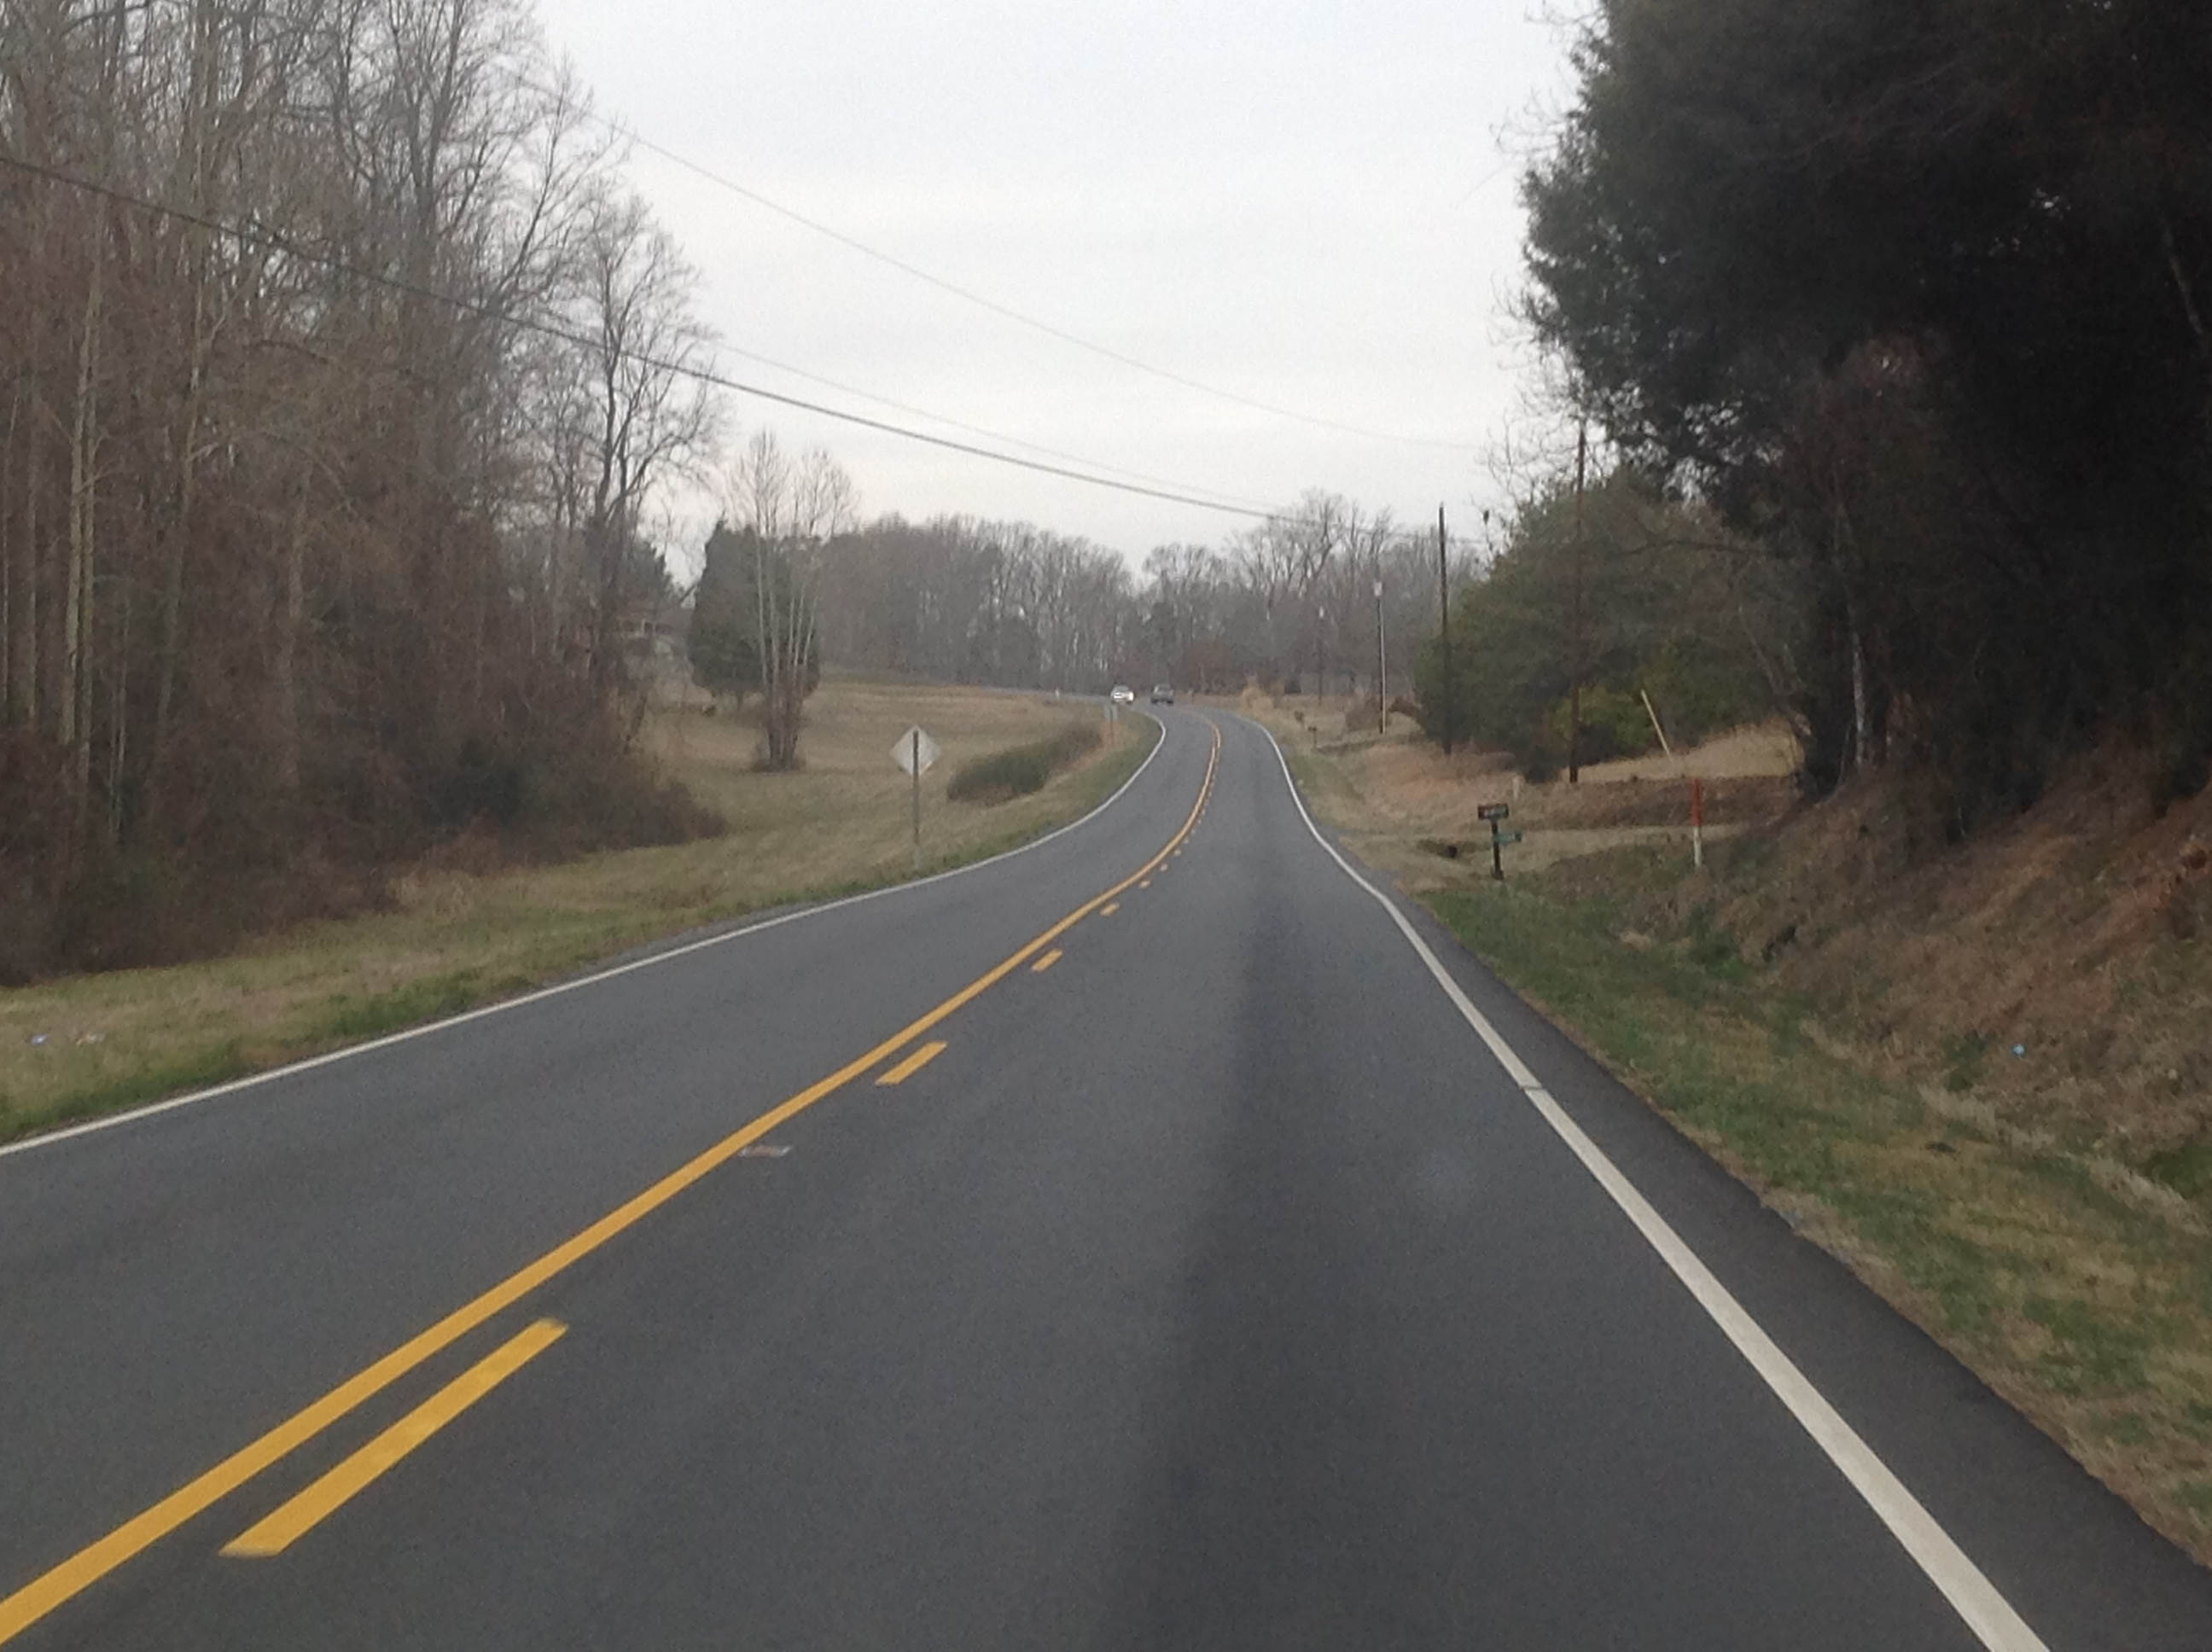
S4.75A Mix
4.75mm (Thin lift) Superpave Mix
  Subdivision roads in Divisions 4 and 12
  NC 27 west of Lincolnton
Notes:
The new S4.75A mix was used on this NC route just west of Lincolnton. Leveling prior to resurfacing was also done with this mix. Half of this map had heavy truck traffic so RS9.5 was used and the rest was resurfaced with thin lift mix.

Slide 16
S4.75A Mix
Separate PSP’s for:
  S4.75A: “Thin-Lift” Superpave mix
  SA-1: “Sand Asphalt”
Mixes are NOT Interchangeable
SA-1 Has been used as a subdivision mix
S4.75A = Preservation Treatment
  Placed @ 3/4“ (approx. 90 lbs/sy)
  For Roads In Fair to Good Condition
Notes:
See Pavement Management 4.75mm Selection Criteria Document

Slide 17
Ground Tire Rubber Modified Asphalt
Still looking for a pilot
Needs to be a project requiring mixes that utilize PG 76-22 modified binder
We have a specification for terminal blended ready to go
M&T will assist with discussions with the Division
Notes:
Like the terminal blend process for the controlled environment aspect and the consistency of the product. Settlement can be an issue but with the terminal blending process it is easily managed through heat and agitation.

Slide 18
Dispute Resolution Process - Mix
Section 7.18.3: DR for Plant Mix
  QA Verification results compared to JMF and not LOP.
  Added specific scenarios for when QA Verification mix sample will trigger Pay Reductions vs. Sublots.

Slide 19
Dispute Resolution Process - Density
Section 10.7.2: Core Verification Testing
  Added Dispute Resolution process for when QC & QA results are outside limits of precision.
  ONE Additional Core is taken whenever a Verification core is cut = “DR Core”
Section 10.5.4: Gauge Verification Testing
  Added Dispute Resolution process for when QC & QA gauge readings vary by more than 2.0%.
  Field confirmation of gauges – QC & QA work together to verify equipment operation.
  If QC & QA cannot determine issues, Soils Lab Technical Trainer is requested to investigate.

Slide 20
Temporary Traffic Control and Law Enforcement SPs for Resurfacing
LUMP SUM pay item includes the following:
    Portable Signs
    Cones and Drums
    Changeable Message Boards and Flashing Arrow Panels (per standard, additional considered extra work)
    Includes 4 flaggers per operation per map
    Additional flaggers paid at $20 per hour for each flagger as approved by Engineer as Supplemental Flagging pay item
Law Enforcement SP
    Guidelines on when Law Enforcement pay item needed – high speed routes, urban intersections, etc.
    Each Law Enforcement officer will be paid Per Hour and not considered incidental or lump sum

Slide 21
Contract Time Considerations for Resurfacing
Division POCs up to $2.5 million under new legislation
Worked with Contract Office / CAPA to better define Contract Time Guidelines for resurfacing projects
Resurfacing production rates (300 – 1000 tons/day):
  Size of the project
  Heavy congested areas or seasonal traffic
  Time restrictions for lane closures, WZTC
  Utility adjustments
  Number of Intersections
Allow 16 days per calendar month
Allow 3 months for winter weather
Pavement Marking limitations
Notes:
Look at information Lamar provided and edit this slide

Slide 22
Disadvantaged Business Enterprise(DBE) Provision Changes
Submit ALL DBEs at bid time
Letters of Intent must be submitted only for those DBEs necessary to meet the goal
  These become the Committed DBEs
  Letter of Intent must be received by noon on the 6th day following the opening of bids
Additional DBEs
  No Letter of Intent submission
  Replacement rules do not apply

Slide 23
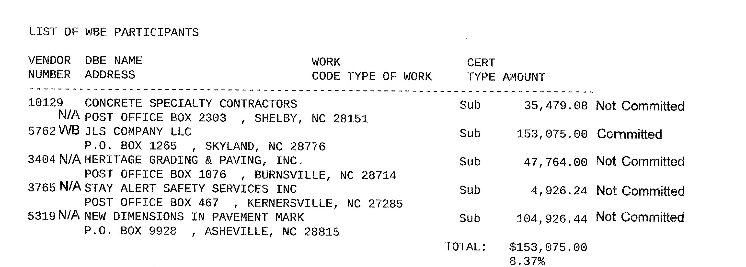
Additional DBE Subcontractors

Slide 24
Replacement of DBE Subcontractors
Committed DBEs can be replaced
  Performance Related Issues
  Decertification
NCDOT must concur with replacement
Submit a DBE/MBE/WBE Replacement Request Form(RF-4) to RE for concurrence
https://connect.ncdot.gov/projects/construction/Pages/Construction-Resources.aspx

Slide 25
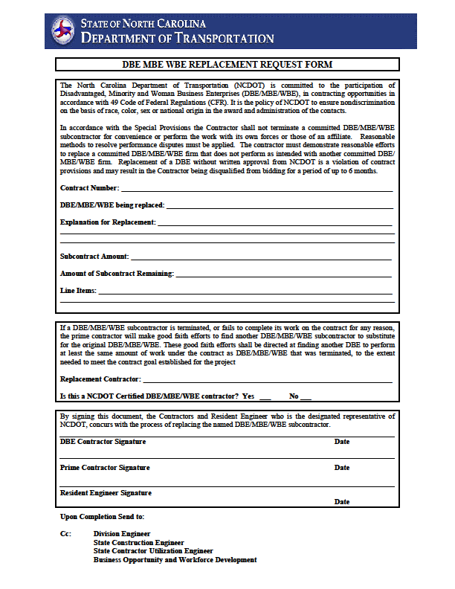
DBE/MBE/WBE Replacement Request Form

Slide 26
Replacement of DBE Subcontractors
Additional DBE can be used as replacement
  Just submit RF-4 Form listing the Additional DBE
  Can list Additional DBE that has completed work
Good Faith Effort for Replacement
  Required when there are no Additional DBEs
  Must seek DBEs to participate in the contract

Slide 27
Prompt Payment
Article 109-4(B)
Requires payment within 7 days
Allows retainage of up to 10%
  Only if no bond is provided
  Mutual agreement between Prime and Sub
  Agreement must be provided to Resident Engineer

Slide 28
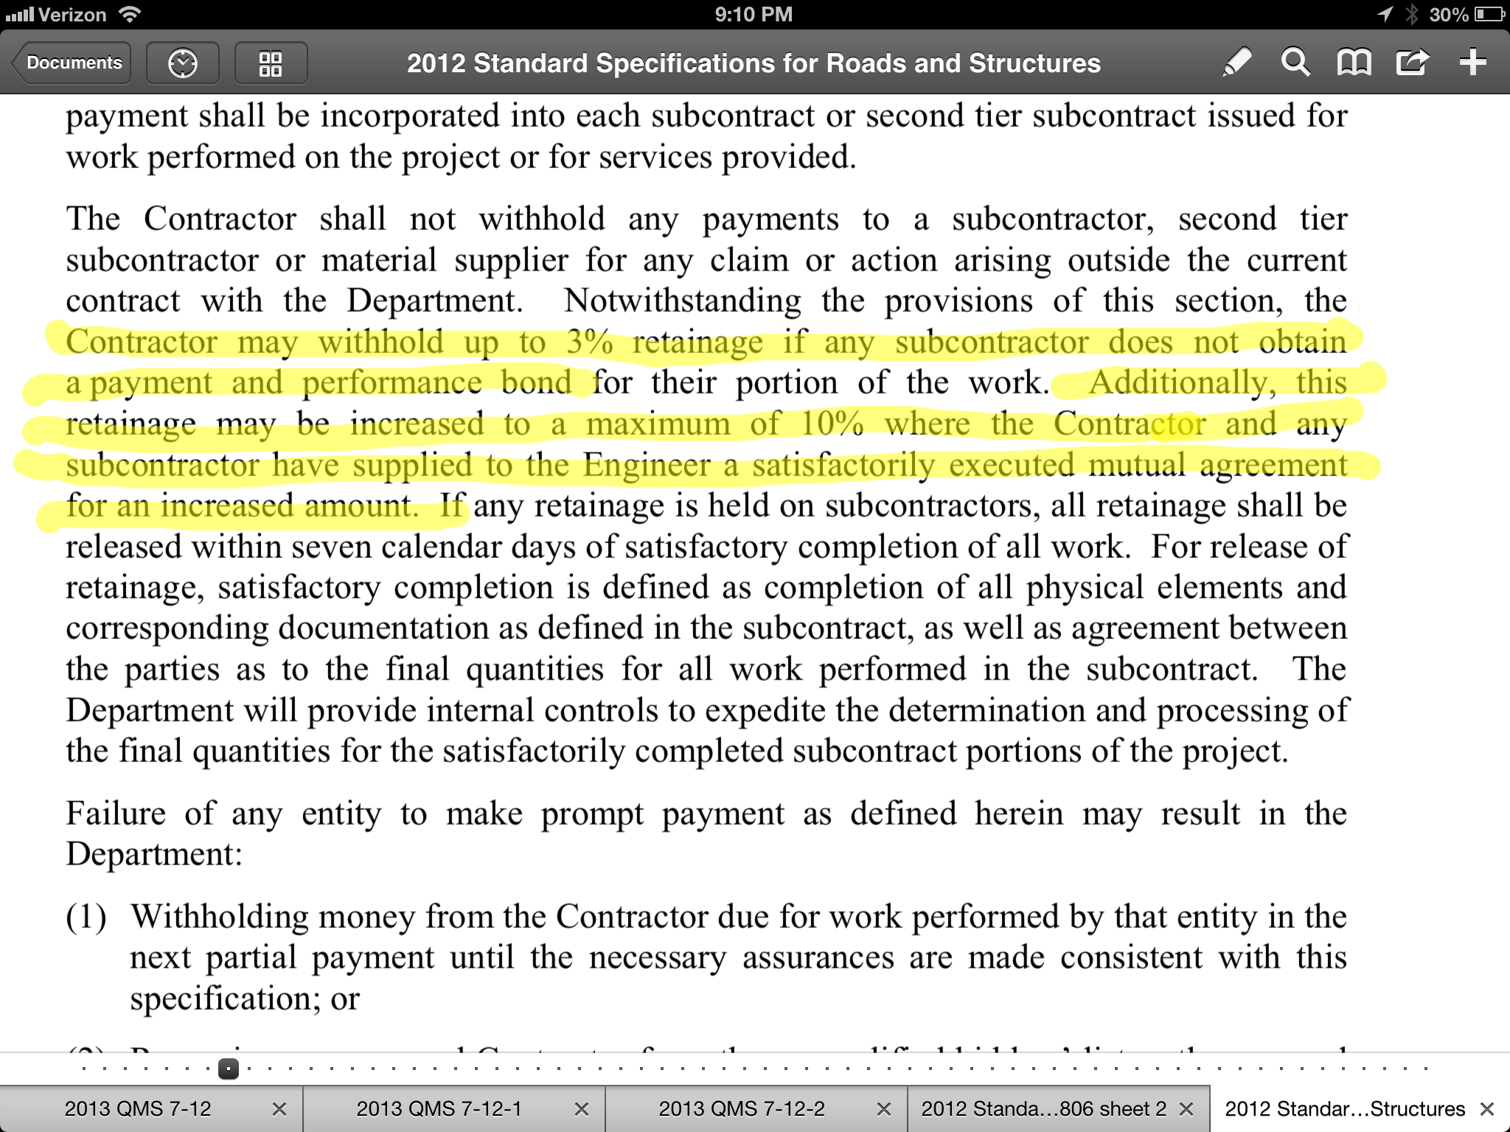

Slide 29
Tablet Pilot Program & QA Lab E-mails
Tablets to QA Supervisors
Improve communication
Access documents out of office
Reduce faxing and submit electronically
E-mail accounts for each QA Lab
E-mail Address as follows for Div. 1 thru 14:
SVC_DOT.QALAB_Div01@ncdot.gov
SVC_DOT.QALAB_Div14@ncdot.gov
Notes:
Not enough info regarding what we are doing with sharepoint – need separate slide for sharepoint and tablets

Slide 30
Asphalt Plants Sharepoint Site
Web-based site to share documents
All asphalt plants will have a folder
Improve internal and external communication
Responsiveness to submittals (JMFs and mix designs)
One producer will have access for Pilot testing
  Blythe Construction, Inc.
  Lake Norman Plant (AS55)
  Blythe Rep must log on from QA Lab computer
  E-mail alerts to Todd and Nilesh
  Mix design documents, JMF Change requests, etc.

Slide 31
Materials and Tests Reorganization
Todd Whittington New Responsibilities
  PG Binder Program Administration
  PG Binder Testing and Inspection
  Asphalt Emulsion Program Administration
  Asphalt Emulsion Testing and Inspection
Shifted additional resources to Asphalt Materials and Services Group to manage additional responsibilities

Slide 32
Materials and Tests Reorganization
All New Asphalt Mix Design and JMF approvals go through one central contact
  Charles Colgate
Asphalt Pavement Specialists can approve changes to existing JMFs
  Very minimal exceptions
    Based on the delta from the original design

Slide 33
QMS Asphalt Classes
https://connect.ncdot.gov/resources/Materials/Pages/QMSAsphaltTrainingSchool.aspx

Slide 34

Online Roadway Technician Course
Partner CC Testing Sites
A-B Tech CC
Brunswick CC
Edgecombe CC
Fayetteville Tech. CC
Guilford Tech CC
Halifax CC
Piedmont CC
Stanly CC
(some do charge a fee)

Slide 35
Comparison of Results
Stanly C.C. Online Roadway Technician Course
Other Recent Classroom Taught Roadway Classes
43 Attendees
4.65
%
Fail
95.35
%
Pass
Jan. 8 & 9, 2014
Jan. 15 & 16, 2014
Jan. 22 & 23, 2014
Feb. 4 & 5, 2014
Roadway Class
Roadway Class
Roadway Class
Roadway Class
Raleigh, NC
Clemmons, NC
Greenville, NC
Asheville, NC
48
72
47
74
Students
Students
Students
Students
10.42
%
Fail
25.00
%
Fail
6.38
%
Fail
13.51
%
Fail
89.58
%
Pass
75.00
%
Pass
93.62
%
Pass
86.49
%
Pass

Slide 36
Questions

